Slide 1
AI-DRIVEN DRONE DETECTION AND TRACKING
BY,
Ismail Suleiman
Koushik G
Lokesh V
Rajeev M
Venkatesh N P S
Phaneendra Chandu

Slide 2
PROBLEM STATEMENT
The rise of low-cost drones used by enemy forces presents a significant challenge to military operations.
These drones are increasingly deployed for surveillance, delivering explosives, and disrupting communications, posing a serious threat to both personnel and critical infrastructure.
However, traditional countermeasures, such as using expensive missiles, are not practical or sustainable when dealing with these low-cost threats. This leads to a situation where it becomes too costly to defend against these threats effectively.

Slide 3
What/Why/How
What is the problem? The problem is the need for effective countermeasures for neutralizing enemy drones, which pose security threats.
Why does this problem exist? The problem exists because traditional defense mechanisms are expensive and less adaptive to evolving drone technology, making it difficult to deploy at scale.
How can we solve it? By developing AI-based detection and tracking systems that can automate and improve the speed of threat identification, we can reduce costs while increasing efficiency.

Slide 4
Shadowing
Observe: Observe military personnel or security teams during their drone detection and neutralization processes. Notice their pain points such as time delays, costs, and manual intervention.
Experience: Try to simulate the experience by using a basic drone tracking system. This will give insight into technical limitations and real-world constraints faced by those on the ground.
Reflect: Reflect on the gaps and needs observed. Understanding the real-life difficulties can inform the design of an AI solution that is efficient, low-cost, and user-friendly.

Slide 5
Says
Thinks
Technology needs improvements.
Costs must be reduced.
Security needs to be robust.
AI can enhance drone detection.
Affordable tech is crucial.
Strong defenses are necessary.
Military personnel
Does
Feels
Explore new AI algorithms.
Investigate security measures.
Research low-cost components.
Hopeful about new innovations.
Concerned about budget limits.
Worried about vulnerabilities.

Slide 6
Define Success
What else are you working toward?
In addition to tracking enemy drones in real-time, consider working on making the system adaptable for different environments (urban vs. rural) or scalable for multiple drone detection simultaneously.
You could also explore integrating the system with existing defense mechanisms or communication systems.
What will make this work successful?
Success will be determined by how efficiently the system can detect, track, and provide actionable data on enemy drones in real-time. Consider aspects like the accuracy of detection, response time, and system reliability under different conditions.

Slide 7
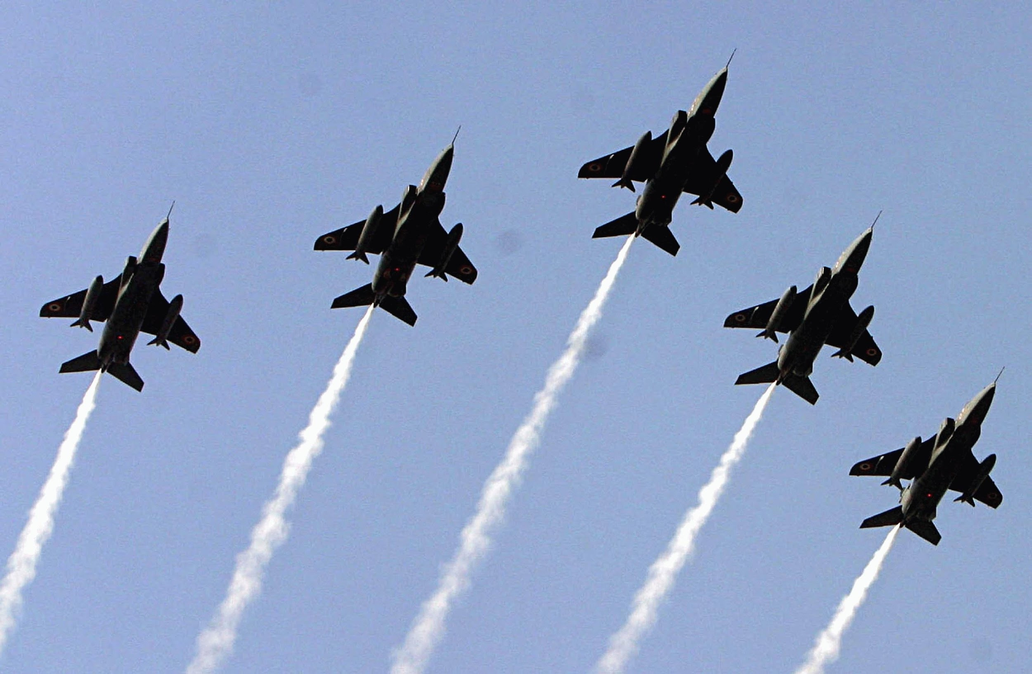
3. What are the measures of success?
Accuracy Rate: Percentage of drones correctly identified as threats.
Latency: Time taken between drone detection and alerting the defense system.
User Adoption: Number of defense personnel or organizations that utilize the system, or the number of times the system is deployed successfully in real-world scenarios.

Slide 8


How Might We (HMW) Questions:
HMW questions can drive focused ideation and help uncover creative solutions for detecting and tracking drones. Here are a couple of relevant HMW questions for your project:
HMW reduce the cost of drone detection and tracking to make it more scalable for defense systems?
HMW integrate AI technologies to ensure real-time, accurate tracking of enemy drones in various terrains and weather conditions?
These questions break down the challenges and open avenues for brainstorming possible solutions that are both innovative and feasible.

Slide 9
VISION CONE
AI-Driven Drone Detection and Tracking for Defense Systems
Perspectives
Multi-sensor data
Edge computing
AI model improvements
Real-time response
Swarm AI
Object tracking
CNN
Past
Now
AI-based detection
Future
Radar and infrared
Cost limitation
Autonomous
Vision
Future systems could detect and neutralize enemy drones quickly and cost-effectively, using AI for movement prediction.
Retropolation

Slide 10
The Present (Now)
AI is used for drone detection, but current systems face high costs and struggle with smaller drones.
Existing technologies like radar, thermal cameras, and AI-based models (YOLO, Faster R-CNN) are expensive or not optimized for military defense.
The Past
Drones were originally developed for surveillance; past detection systems used radar and infrared, but struggled with smaller drones.
Deep learning models like CNNs, YOLO, and MobileNet revolutionized real-time drone tracking.

Slide 11
The Future (Vision for 5-10 Years)
AI will improve to detect drones with more accuracy, speed, and real-time neutralization of threats.
Advanced sensors (LiDAR, thermal cameras) combined with AI will enhance precision and range in detection.
Retropolation and Perspectives
Future systems could detect and neutralize enemy drones quickly and cost-effectively, using AI for movement prediction.
Technological needs include advancements in edge computing, improved AI models, and integration with military hardware.

Slide 12
IDEATION
Title
Automated Drone Classification and Threat Assessment System
Summary: AI system classifying detected drones by type and threat level for efficient defense response.
How It Works: AI identifies drones based on parameters like speed and altitude, ranking threats to optimize resource use.
Needs & Opportunities: Low-cost enemy drones threaten military operations with surveillance and explosives, making traditional countermeasures too costly, highlighting the need for efficient, automated threat assessment.
Value & Benefit: Make the system adaptable for different environments, scalable for multiple drones, and compatible with current defense systems.
Success Criteria: Success depends on real-time detection, classification accuracy, and reliable data in varied conditions.

Slide 13
Types of Prototypes
AI-Driven Drone Detection and Tracking Project: the distribution of effort among low-fidelity, mid-fidelity, and high-fidelity prototypes will depend on the complexity of the project and the stage of development.
20 %
40 %
40 %
Low-Fidelity Prototypes
Mid-Fidelity Prototypes
High-Fidelity Prototypes

Slide 14
Process Percentage Distribution
Low-Fidelity Prototypes - 20%
Focus: Early brainstorming, exploring ideas, and understanding system flow.
Reason: These prototypes help establish the foundation, but minimal time is spent as they are rough sketches or wireframes.
Mid-Fidelity Prototypes - 40%
Focus: Testing specific features, refining the workflow, and evaluating the integration of AI models for detection and tracking.
Reason: This stage is critical to ensure the system's key functionalities (e.g., drone detection algorithms, user flow, and basic interaction) work as expected. More time is allocated here to validate technical feasibility.
High-Fidelity Prototypes - 40%
Focus: Finalizing details, testing real-time scenarios, and presenting the system to military personnel.
Reason: The high-fidelity stage is essential for creating a realistic, functional prototype that closely resembles the final product. This ensures usability, system performance to use military personnel.

Slide 15
Workflow
Data Collection
DATA
PRE-PROCESSING
MODEL
SELECTING
:
Distance Estimation and Tracking
Model Training
Integration and Real-Time Testing

Slide 16
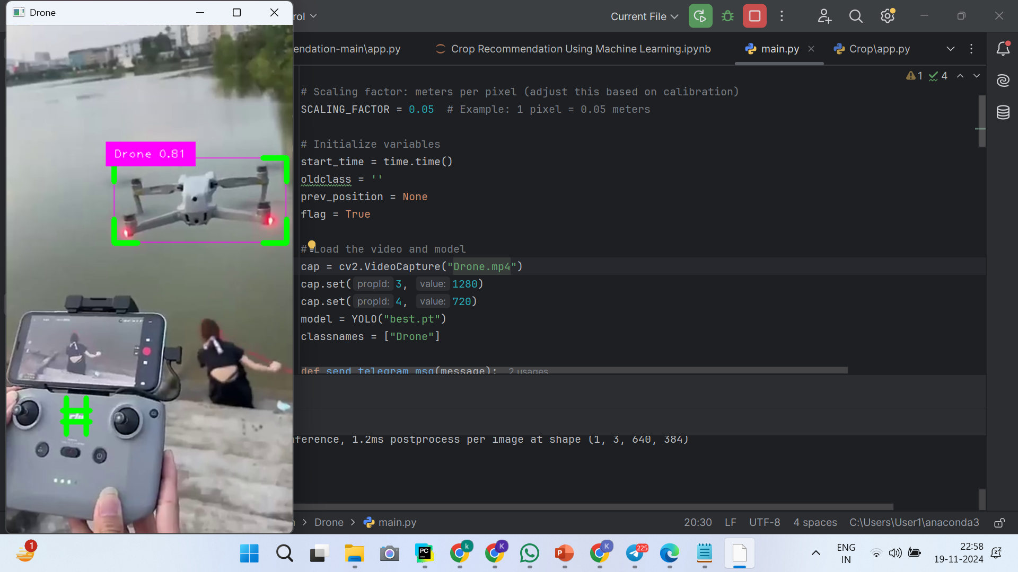
Experimental Result
The image showcases a real-time drone detection system identifying a drone with 81% confidence. The bounding box highlights the drone in the video feed, demonstrating the system's ability to detect and track drones effectively.

Slide 17

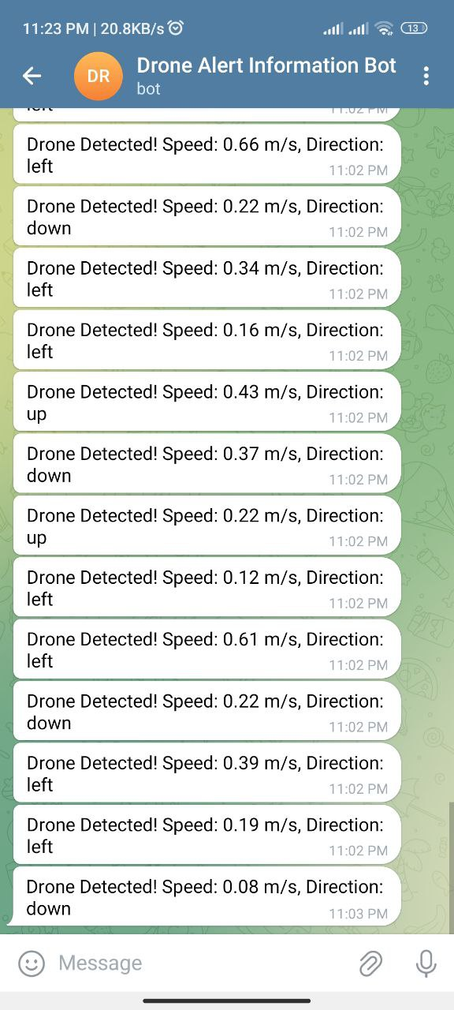
Experimental Result
The Telegram notification from the "Drone Alert Information Bot" reports a detected drone with a speed of 0.14 m/s, emphasizing real-time detection capabilities, including speed calculation and alerting users instantly through the messaging platform.

Slide 18
Thank You

